Slide 1
Enhancing Li adsorption by lowering the fermi level

Slide 2
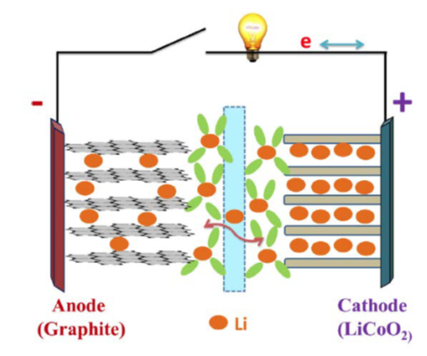
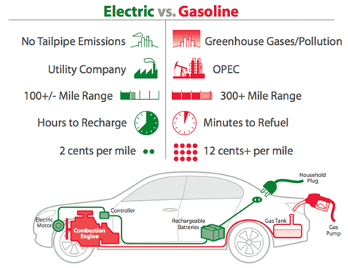
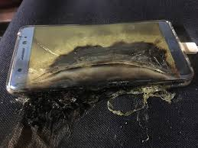
Introduction
Li-ion batteries: current status & challenge (energy density & stability)
Goriparti et al. J. Power Sources, 2014, 257
www.plugincars.com
Notes:
Lithium-ion batteries, the leading energy storage technology, have been studied for decades. Typically, a battery have three main components: cathode, anode and electrolyte. When powering loads, electron flow from anode to cathode via circuit, and ions flow from anode to cathode via electrolyte, and when charging, the directions of flows are reversed. For most batteries people use graphite as anode and LiCoO2 as cathode. However, there are still several challenges for people to overcome, such as increasing the energy density, accelerating the kinetics and improving the stability and safety.

Slide 3
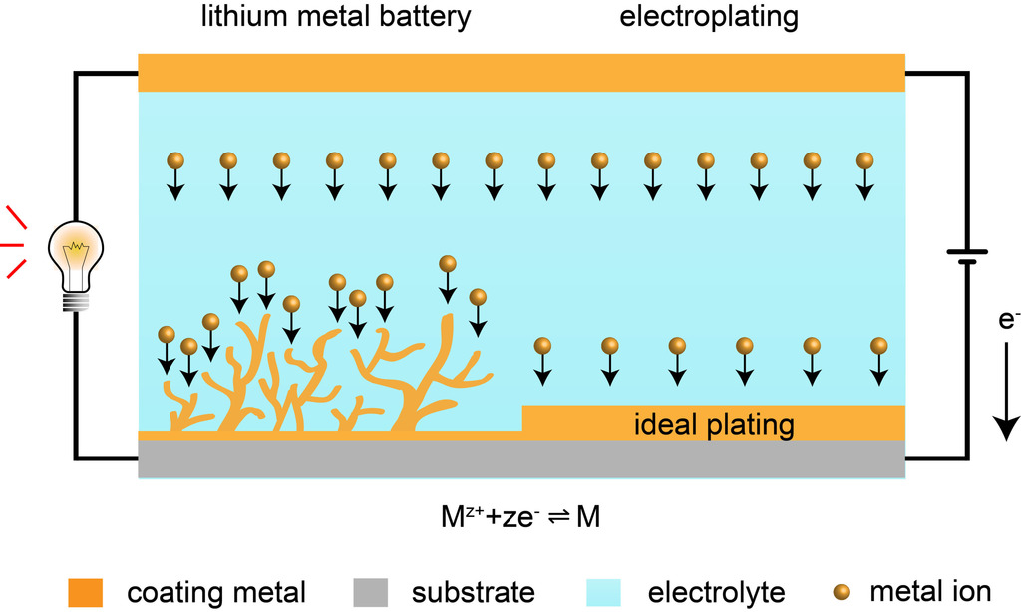
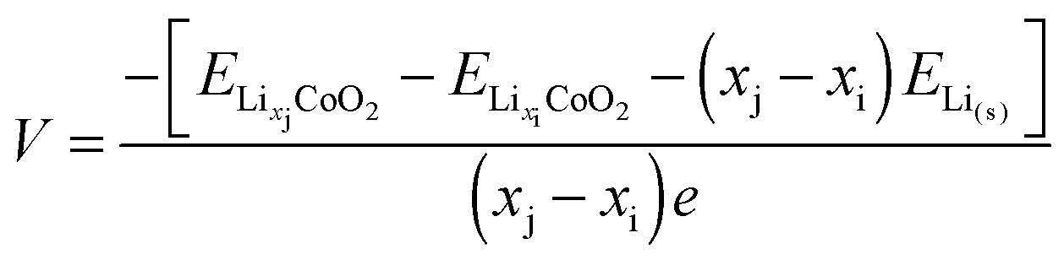
Introduction
Enhance Li adsorption: higher voltage & suppress dendrite formation.
Islam et al. Chem. Soc. Rev., 2014, 43
Sun et al. Angew. Chem., 2019, 59
Notes:
In order to make better Li ion batteries, people have tried to enhance Li adsorption on both cathode and anode, because for cathode, stronger adsorption will result in higher voltage, as you can see the energy of Li adsorbed species in the voltage formula, and for anode, weak adsorption will result in the aggregation of Li and dendrite formation, which will cause short circuit of battery.

Slide 4
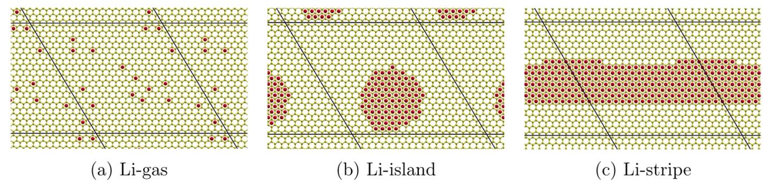
Introduction
Graphene: from weak adsorption to Li aggregation.
Adsorption energy of Li on graphene: -1 eV ~ -1.6 eV (E_{ads} = E_{graphene+Li} - E_{graphene} – E_{Li})
Formation energy of Li metal: -1.9 eV
Shaidu et al. J. Phys. Chem. C, 2018, 122
Notes:
A famous example of weak Li adsorption is graphene. As we all know, graphene has superior electronic conductivity and mechanical strength, which are ideal for electrode materials. However, as we can see, Li adsorption on graphene is very weak, with the adsorption energy even smaller than the formation energy of Li metal in magnitude. Therefore, even under dilute concentration, Li atoms tend to aggregate as island or stripe on graphene, which will eventually evolve to Li dendrite.

Slide 5
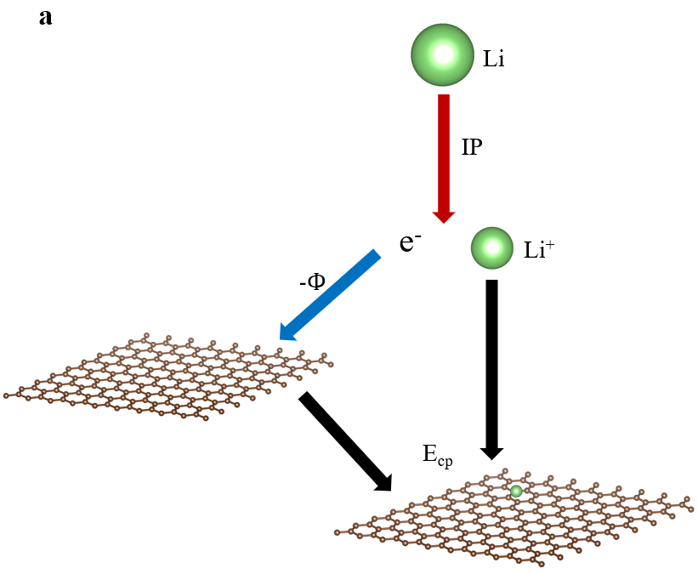
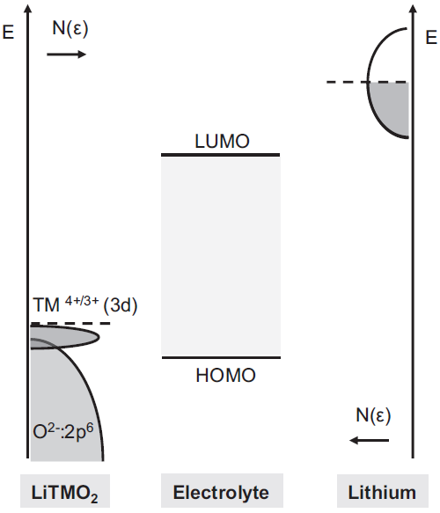

Introduction
Adsorption energy and electronic energy level.
Cherkashinin et al. J. Electrochem. Soc 2019, 166
Gong et al. in preparation
Notes:
Before trying to enhance Li adsorption, let’s first look at what controls Li adsorption energy. Typically, when talking about energetics in Li ion batteries, people would refer to the electronic energy levels of the components as shown here, because the charge and discharge process are actually charge transfer processes. For Li adsorption, in a recent work, we think propose a three-step mechanism to understand the Li adsorption energy. When a Li atom approach a 2D material, first it ionize to become a Li ion and an electron, which cost the energy equal to ionization potential, then the electron transfer to the 2d material and release the energy equal to the workfunction, and finally the Li ion couple with the charged 2d material and have an energy change of coupling energy. Therefore, it is straightforward to enhance the Li adsorption by lowering the electronic energy levels of materials, and for metals it is equal to lower the fermi level.

Slide 6
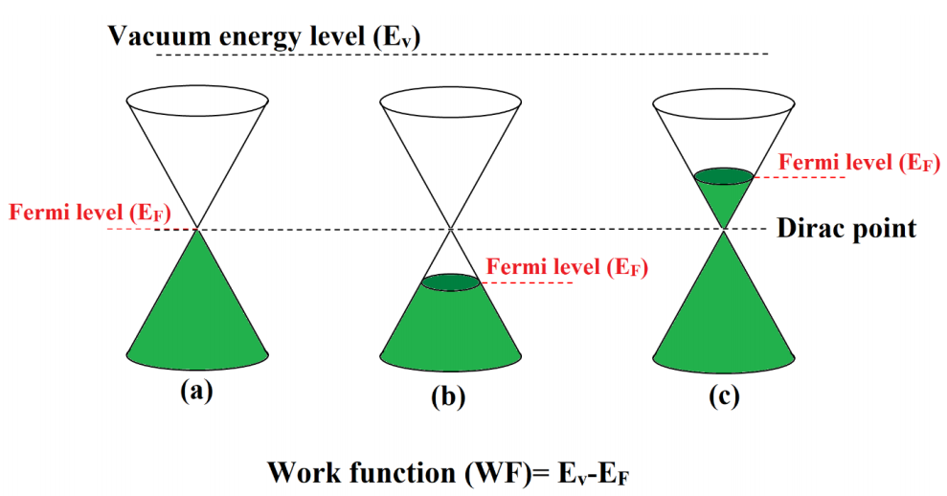
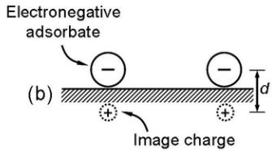
Introduction
Lowering fermi level: doping & functionalization
Doping: remove electrons out from the materials.
Functionalization: form dipoles
Naghdi et al. https://arxiv.org/pdf/1905.06594
Kaja et al. https://tel.archives-ouvertes.fr/tel-00515370
Notes:
So how to lower the position of fermi level? Typically, there are two ways to do that. The first one is doping, as we can see in the right figure, if we add p-type dopant into the system, we actually remove electrons from the system, thus the fermi level would be lower; on the contrary, if we add n-type dopant, the fermi level would be higher as a result of adding electrons into the system. Another way is surface functionalization, or add functional groups onto the substrate. If we add electronegative adsorbates, like halogen atoms, they will adsorb electrons from the substrate, forming dipoles pointing from the substrate to the adsorbate, therefore making the electron harder to escape from the substrate to the vacuum, which results in lower fermi level.

Slide 7
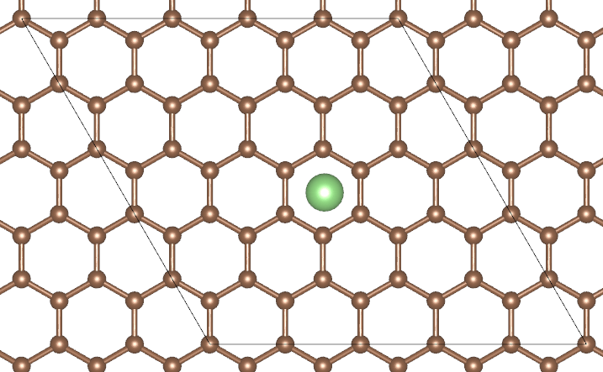
Methods
Structure construction: B-doped graphene & F-functionalized graphene & vacancy
5*5 supercell (50 Carbon atoms): low defect concentration & interaction between periodic images
Notes:
So in this project, we try to enhance Li adsorption by lowering the fermi level of the system. We use graphene as the example system, and in order to lower the fermi level, we dope the graphene with Boron, the element with one electron less than carbon, and we use fluorine, the most electronegative element, as the electronegative adsorbate to functionalize graphene. We also include graphene with vacancy in our study, because vacancy is commonly seen in all materials systems, and formation of vacancy is also a process of removing an electron from the system. Here we use a five-by-five supercell with 50 carbon atoms as our study system, because we want to keep a low defect concentration and avoid interaction between periodic images. To simplify the problem here we only consider adsorption of a single Li atom.

Slide 8
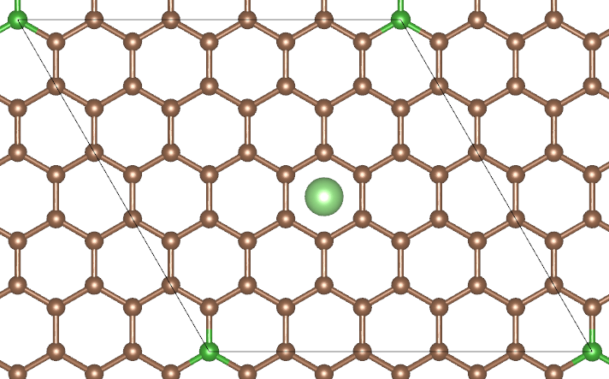
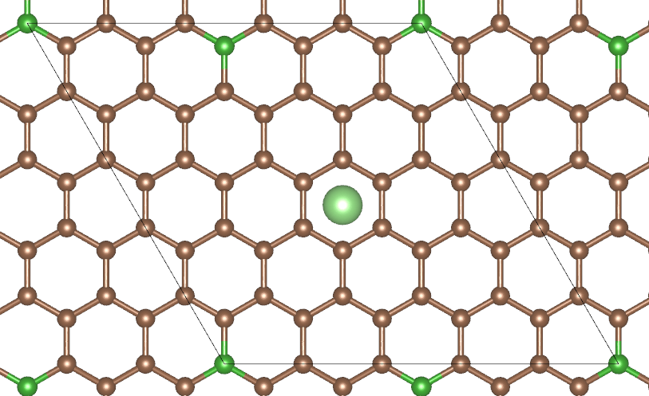
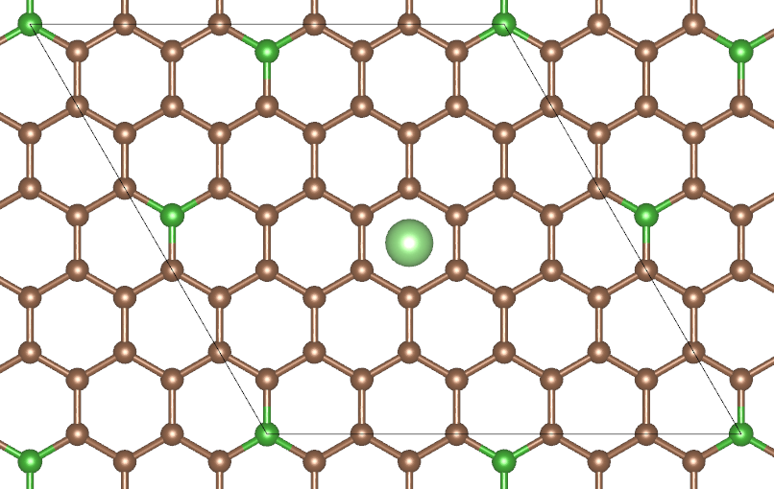
Methods
Structure construction: B-doped graphene & F-functionalized graphene & vacancy
C₄₉BLi C₄₈B₂Li C₄₇B₃Li
Boron dopants repel each other: Endo et al. Carbon 2000, 38
Previous work about Li close to doping sites: Gong et al. J. Phys. Chem. C 2017, 121;
Notes:
For boron-doped graphene, we choose three doping concentrations as study examples, and when building the doping structures we manage to separate the dopants from each other because here boron atoms will all carry positive charge and they will repel each other. And we also keep the dopant sites away from the Li adsorption site, because there is previous work that already studied the case of Li close to the defect sites.

Slide 9
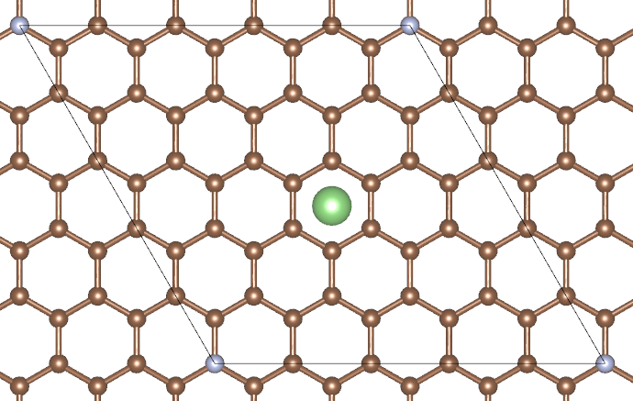
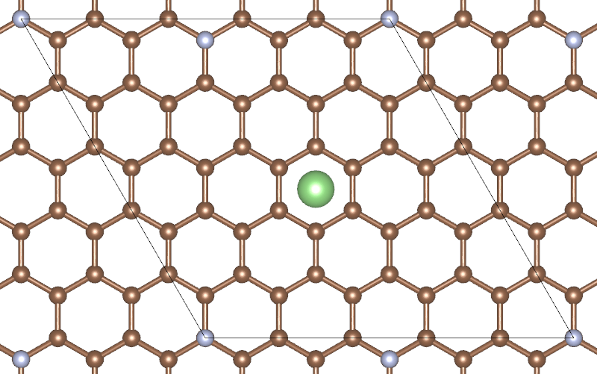
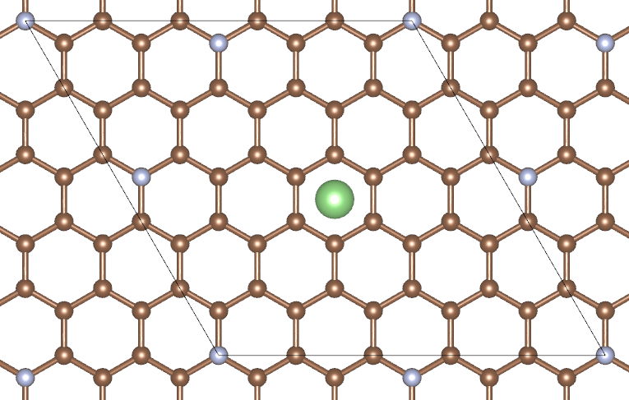
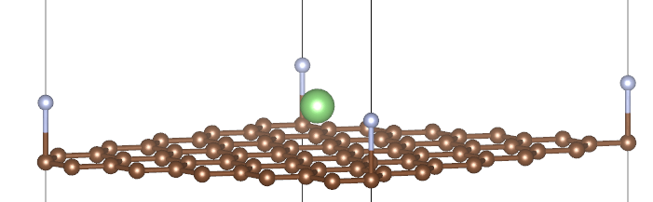
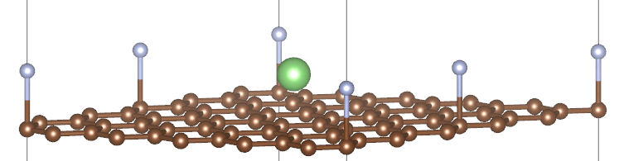
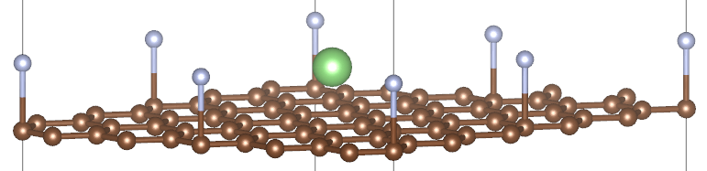
Methods
Structure construction: B-doped graphene & F-functionalized graphene & vacancy
C₅₀FLi C₅₀F₂Li C₅₀F₃Li
Notes:
For fluorine functionalized graphene, the choice of F adsorption sites follows similar guidelines with the case of boron doping.

Slide 10
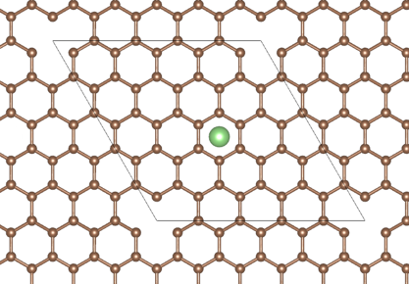
Methods
Structure construction: B-doped graphene & F-functionalized graphene & vacancy
C₄₉
Notes:
And for graphene with vacancy, we only consider one vacancy concentration because the formation energy of vacancy is much larger than that of doping and functionalization and in reality, we cannot make structures with very high vacancy concentrations.

Slide 11
Summary
B-doping, F-functionalization, vacancy all lead to lower fermi level of graphene.
Lower fermi level, stronger Li adsorption.
Li adsorption is a charge transfer process.
Difference between B-doping and F-functionalization: different electrostatic interaction
Down shift of fermi level and charge transfer from Li to graphene: from band structure.
Notes:
In summary, in this project we test the idea of enhancing Li adsorption on graphene by B-doping, F-functionalization and vacancy, and we find that these modifications can all serve to lower the fermi level of graphene by calculating the position of fermi level and vacuum level from DFT. Then, by DFT energy calculation and geometry optimization, we calculate the Li adsorption energy and find that, the lower the fermi level, the stronger Li adsorption. And we further check that Li adsorption is a charge transfer process by bader charge analysis. We also use bader charge analysis to find that the difference between B-doping and F-functionalization results from the different electron distribution and different electrostatic interaction between the Li ion and the substrate. Finally, we understand the lowering of fermi level and charge transfer by band structure calculation.

Slide 12

Acknowledgement
We sincerely thank Prof. Rafael Gomez-Bombarelli for great teaching!
Notes:
In summary, in this project we test the idea of enhancing Li adsorption on graphene by B-doping, F-functionalization and vacancy, and we find that these modifications can all serve to lower the fermi level of graphene by calculating the position of fermi level and vacuum level from DFT. Then, by DFT energy calculation and geometry optimization, we calculate the Li adsorption energy and find that, the lower the fermi level, the stronger Li adsorption. And we further check that Li adsorption is a charge transfer process by bader charge analysis. We also use bader charge analysis to find that the difference between B-doping and F-functionalization results from the different electron distribution and different electrostatic interaction between the Li ion and the substrate. Finally, we understand the lowering of fermi level and charge transfer by band structure calculation.

Slide 13
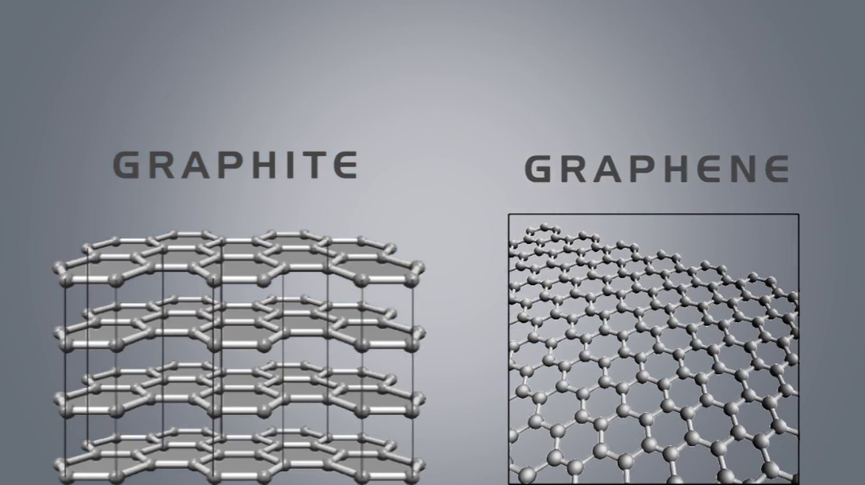
Open question & discussion
How to compare fermi level of bulk systems without reference of vacuum level?

Slide 14
How to enhance Li adsorption

Slide 15
Graphene as an example

Slide 16
Two ways: doping & functionalization

Slide 17
Structure constructions

Slide 18
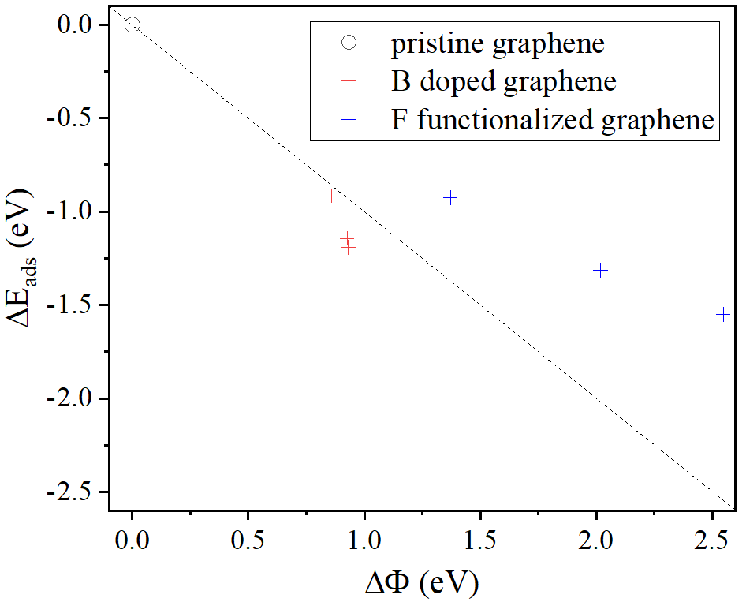
Results: adsorption energy change vs. work function change

Slide 19
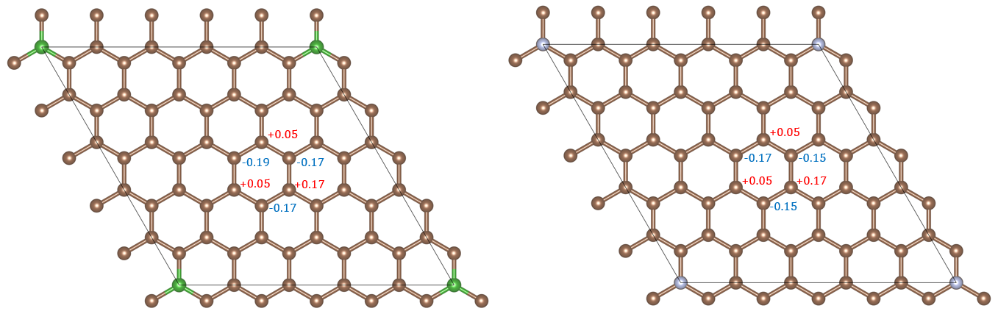
Bader charge analysis for the difference between doping and functionalization.

Slide 20
Summary

Slide 21
Open discussion

